Slide 1
PRACTICE MODULE Machine Reasoning (MR) Reasoning Systems (RS) Cognitive Systems (CGS)
FOR CERTIFICATE IN:
INTELLIGENT Reasoning Systems (IRS)

Slide 2
Practice Module : Learning Outcomes
Certificate in Intelligent Reasoning Systems (IRS)
The goal of this certificate is to teach participants the specialist skills and best practices for engineering industrial projects of business rule based decision making systems, business process management systems, business resource optimization systems, and cognitive systems. It is targeted at IT professionals and artificial intelligence engineers who create complex software systems with considerable business rules, business processes, multiple data sources and need reasonable understanding of the knowledge management, data modelling, process modelling, resource planning and optimization, automated machine reasoning for decision support, and software development.
Key Takeaways:
Expose participants in a supervised manner to real world problems so that they may practice the use of the skills they have learned during the individual course modules in a real world setting and obtain expert advice and guidance when needed.
Enable participants to demonstrate their proficiency across all of the skills that they have learned in the course modules and hence be certified as competent at the Certificate level.
Provide a formal grading mechanism so that the certificate may be used as one component in the NUS-ISS Stackable Master of Technology (MTech) in Intelligent Systems.

Slide 3
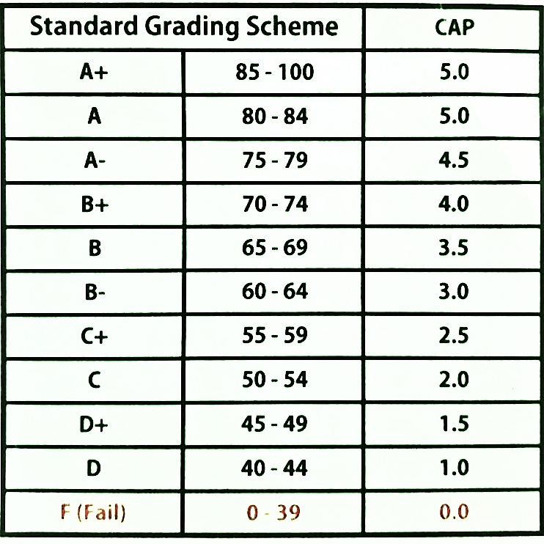
Practice Module : Components
“PASS” >= 50 marks
The assessment for this practice module (and hence for the compete certificate) will comprise below three assessment components:
[ Project Work: Assessments & Workshops ] deliverables of test/quiz/workshops during course
[ Project Work: MVP ] project report & runnable software/hardware system before exam
[ Examination ] written open-book examination
* MVP: minimal viable product
All of the above components will be graded and assigned an individual mark by the assigned ISS project supervisors. A Board of Examiners will review the marks and moderate where required. A participant must attain a minimum overall score of 50% in order to pass the practice module and hence be awarded the Certificate in Intelligent Reasoning Systems.
Assessment Component | Weight
Examination | 50%
Project Work: In-class assessment(s) & workshop deliverables | 10%
Project Work: MVP* reasoning system deliverables | 40%

Slide 4

Practice Module : Exam
3 hour open book individual exam
Pencil can be used for drawing.
Internet (re)search is NOT allowed.
Bring your NUS matriculation ID card and Identification Card.

Slide 5

Practice Module : In-class assessment(s) & workshop(s)
One or more deliverables of assessments and workshops are (to be) completed during your modular courses.

Slide 6
Practice Module : MVP Project
[ Group Project ] What are the requirements?
Form a project team of 2 - 4 members, appoint a team leader.
Identify a relevant business/research problem in the domain of knowledge discovery, hybrid machine reasoning, recommendation or optimization. Propose, design and create an intelligent reasoning system for the business need/problem.
The proposed project must develop, integrate, and demonstrate any three or more aspects out of following four technique groups:
Decision automation: Business rules & process OR Knowledge based reasoning techniques
Business resource optimization: Informed search OR Evolutionary computing techniques
Knowledge discovery & data mining techniques, e.g. recommendation; diagnosis; etc.
System designed with cognitive techniques or tools, e.g. components of knowledge base: knowledge graph, frame systems, user-interface supporting human mode of communication like natural language, chat-bot, etc.
Resulting software/hardware system should have user interfaces, results interpretation and visualization where deemed necessary. To minimize “reinventing the wheels”, the delivered system is encouraged to adopt existing open source sub-modules and/or application programming interfaces APIs, but the system must also work as a standalone application when internet is inaccessible. Teams can explore other relevant technologies to extend the system/solution for more effective business problem solving, which can be considered for value-added marks. Teams must demonstrate (write in report) their ability to apply and practice the knowledge, techniques and skills they have learnt from the courses.

Slide 7
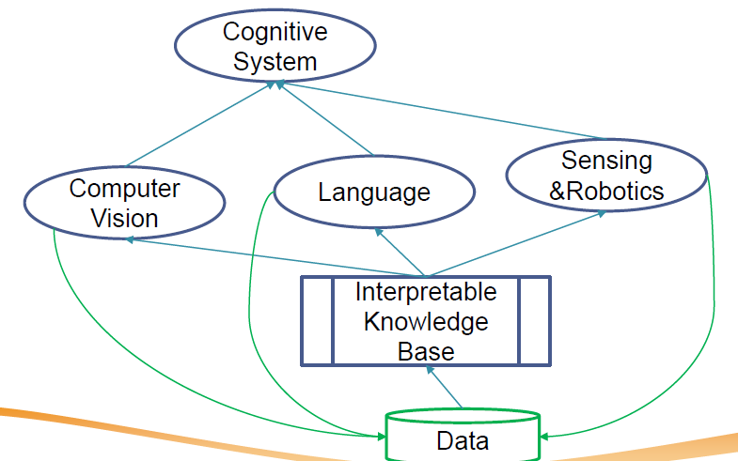
What are Cognitive Systems?
Systems that exhibit human-like intelligence through processes like learning, reasoning, and memory

Slide 8
Cognitive Systems Application Areas
Product applications embed cognitive technologies in a product or service providing customer benefits like ease of use, simplicity, or automation.
Process applications embed the technology in an organization's workflow automating some tasks to get things done faster, better, cheaper, or some combination.
Insight applications use advanced analytic capabilities and machine learning to uncover insights to make better operational and strategic decisions based on large amounts of data

Slide 9
Practice Module : MVP Project
[ Group Project ] What are some project ideas?
Children Development Monitor / Milestone Tracker https://www.cdc.gov/ncbddd/actearly/index.html
Augmented Reality: Evidence-based tools to help you teach social-emotional skills to students with autism or ADHD http://www.brain-power.com/
Dynamic Book Order Handling System https://github.com/IRS-MR/IRS-MR-2019-01-19-IS1PT-GRP-X-Men-Online_Order_Management_System
Query Answering Information Retrieval Chat-Bot https://github.com/IRS-CGS/IRS-CS-2019-04-27-IS1PT-GRP-ISSChatBot
Algorithmic Trading System (ATS) for Crude Palm Oil Futures https://github.com/IRS-PM/Workshop-Project-Submission-Template-Trading
IT Project Release Optimizer https://github.com/IRS-PM/Workshop-Project-Submission-Template-GA-Optimizer
IBM Watson® Discovery service https://www.ibm.com/cloud/garage/architectures/cognitiveDiscoveryDomain/overview
IBM Watson® Assistant https://www.ibm.com/cloud/watson-assistant/
Google Dialogflow https://dialogflow.com/
MyCroft https://mycroft.ai/
Past student project references: https://github.com/IRS-PM

Slide 10
Practice Module : MVP Project
[ Group Project ] What to develop?
A 5-minute video clip to promote/sell your system/solution, covering:
Business Pain & Value; Use Case Demo; Pricing;
A 5-minute video clip to describle high level system design your system/solution, covering:
System Design; Technical explanation of use cases;
A runnable intelligent reasoning system;
A group project report with relevant attachments, including:
Business Case / Product Plan / Market Research
System Design / Model
System Development & Implementation in tools, e.g. KIE suite, python, Dialogflow, MyCroft AI.
Appendix of report: Project Proposal
Appendix of report: Mapped System Functionalities against knowledge, techniques and skills of modular courses: MR, RS, CGS
Appendix of report: Installation and User Guide
Appendix of report: 1 or 2 pages individual project report per project member, including:
Individual reflection of project journey: (1) personal contribution to group project (2) what learnt is most useful for you (3) how you can apply the knowledge and skills in other situations or your workplaces

Slide 11
Practice Module : MVP Project
Other references:
[ Naming Convention ] CourseCode-StartDate-BatchCode-TeamName-ProjectName.docx
[ Template ] Project Proposal (appendix of project report)
IRS-PM-PROPOSAL-2019-07-10-Stackable1-GRP-AwsomeSG-HDB_BTO_Recommender.docx
[ Template ] Project Non-Disclosure Agreement (NDA)
IRS-PM-NDA-2019-07-10-Stackable1-GRP-AwsomeSG-HDB_BTO_Recommender.docx

Slide 12
Practice Module : MVP Project
[ Group Project ] What to submit?
Create Github repository using template:
https://github.com/IRS-PM/Workshop-Project-Submission-Template
As a project group: Prepare below four files with naming convention:
A member-github.txt, containing:
Group name, e.g. AwsomeSG
All member’s full name (as shown on your student ID/NRIC/FIN/Passport)
All member’s student IDs, e.g. A1234567B; or masked NRIC, e.g. S****123T
Weblink to your online github project repository, e.g. https://github.com/...
A downloaded github repo zip, e.g. IRS-PM-2021-01-16-IS03PT-GRP-AwsomeSG-ReleaseOptimizer.zip
Two separate video files, e.g. IRS-PM-2021-01-16-IS03PT-GRP-AwsomeSG-ReleaseOptimizer-promotion/system.mp4/wmv/mov/avi/etc
Finally, compress all above files into one single .zip file, naming convention, e.g. IRS-PM-2021-01-16-IS03PT-GRP-AwsomeSG-ReleaseOptimizer.zip, then upload to LumiNUS Practice Module project submission folder.
As an individual: Prepare and submit confidential peer review form to LumiNUS separate folder.

Slide 13
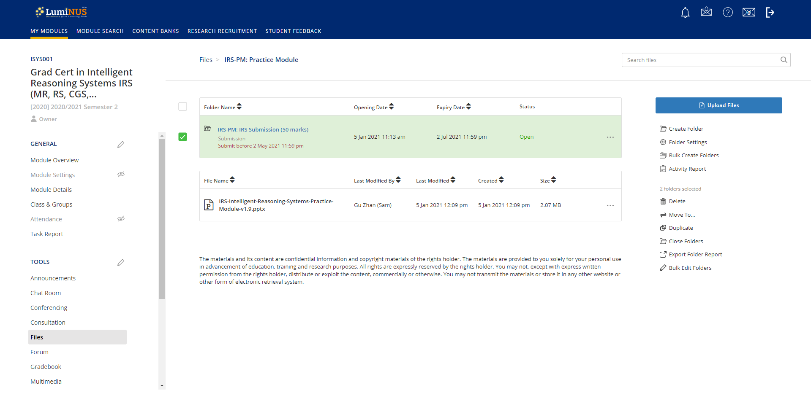
[ Group Project ] Where to submit?

Slide 14
Practice Module : MVP Project
[ Group Project ] How to evaluate?
The deliverables will be assessed in a scheme including aspects of:
Business Value (shown in report/ market research)
System Design, e.g. Smart functions; Technological advancement (shown in report/ documentation)
System Implementation (run and use your system/ user-guide)
Presentation Videos
Project Contribution: peer-review; team-size
Value Adds, e.g. relevant techniques via self research; intuitive user interface
with focus on System Design & System Implementation & Individual project contribution

Slide 15
Practice Module : MVP Project
[ Group Project ]
Submission due by 23:59 on 1st Sunday of May (1st half of year) or November (2nd half of year)

Slide 16
Practice Module : MVP Project
[ Example Past Project ]
https://github.com/IRS-PM

Slide 17
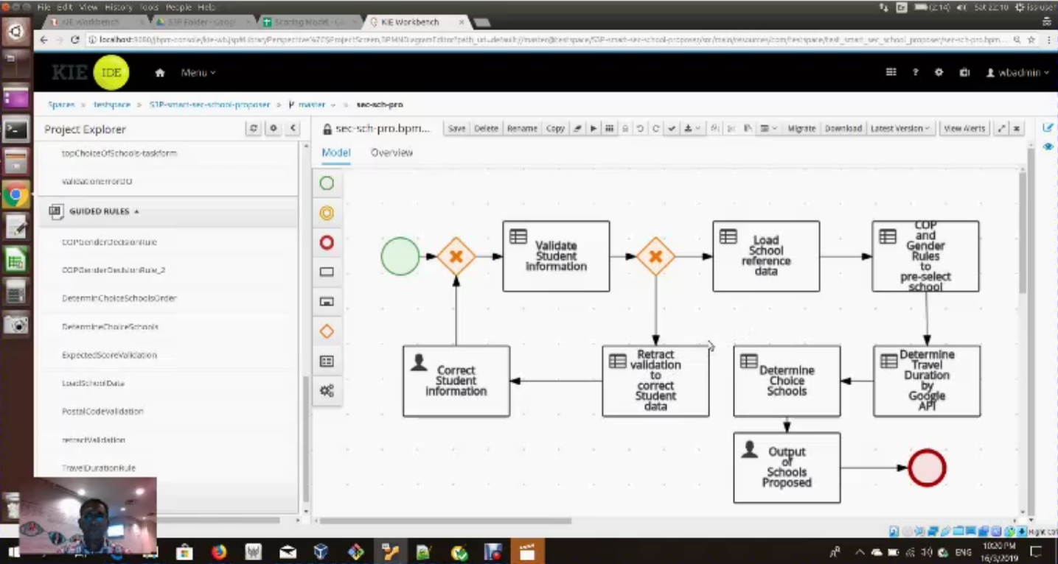
[Education] Secondary School Proposer
Source https://github.com/IRS-MR/IRS-MR-2019-01-19-IS1PT-GRP-aiVoyagers-S3P-smart-sec-school-proposer
Notes:
EXECUTIVE SUMMARY / PAPER ABSTRACT
Singapore has a strong education system. Singapore students aim high and they achieve very good results. This is recognised around the world. Singapore has good schools, with capable school leaders and teachers, and the facilities that are amongst the best in the world.
After their primary education, Singapore students face heavy competition to get admission to the top secondary schools. To manage the secondary school admission process, Ministry of Education has a process wherein every year students are admitted in schools primarily based on their PSLE (Primary School Leaving Examination) score. The other popular criteria used by students to select secondary schools are the Co-Curricular Activities (CCA) offered by the schools and the distance of the school from their home.
Our team of 4 Singapore residents have also gone through the selection process of selecting secondary schools for our children and the biggest challenge we found was to collect the disparate information from different sources and most importantly how to analyse this data to arrive at the most appropriate schools for our children.
We believe that many other Singapore parents would also be finding similar difficulties in analysing the schools available, so to alleviate their pain we decided to embark on this project to provide a smart secondary school proposer which would analyse and propose the best schools for their children based on their choices. For this project we have decided to use the school data available in public domain like MOE website and Kiasu Parents to name a few. By using the knowledge and techniques imparted in our machine reasoning course, we first built a database of schools and their attributes from the MOE website. We used KIE tools JBPM and Drools to build the business processes and the decision rules. We also used Java and Google APIs to get real time information on the distances from home.
We had a tough but interesting time working on this project. It also allowed each one of us to understand the intricacies involved in choosing the right school for our children based on well-reasoned factors. We also felt that the scale and scope of the project was much bigger than what we initially thought and more time was required to explore all options.

Slide 18
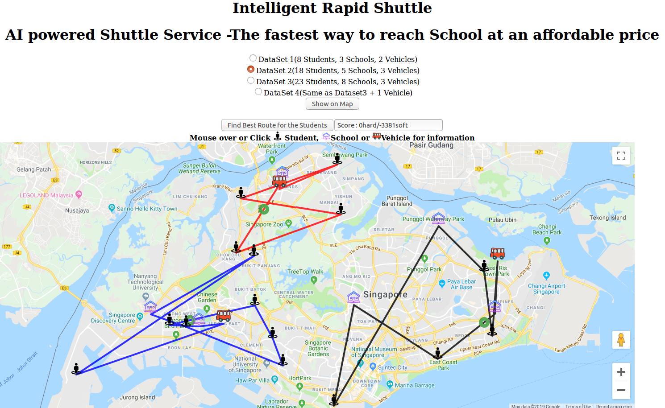
[Education] School Shuttle Scheduler
Source https://github.com/IRS-RS/IRS-RS-2019-03-09-IS1PT-GRP-aiVoyagers-irs-Intelligent-Rapid-Shuttle
Notes:
EXECUTIVE SUMMARY / PAPER ABSTRACT
In Singapore shuttle services to ferry students from their home to school and back is quite common. Probably every Singaporean would have travelled in a shuttle service during their student days.
Our team of 4 Singapore residents have also gone through the process of selecting shuttle services for our school going children and the biggest challenge we found was to find a service which takes the shortest distance to reach the school from our house at a reasonable cost and able to service multiple schools at the same time.
We believe that many other Singapore parents would also be finding similar difficulties in selecting shuttle services for their children for a nominal cost. This provides a greater opportunity to address the gap in the market and thus we decided to embark on this project. In this project, we are assuming that we are a service provider having few depots operating shuttle buses at our disposal. We would be providing shuttle services optimized through the implementation of Reasoning Systems Optimization techniques using KIE workbench, Drools and OptaPlanner.
We felt that the scale and scope of the project was such that many more options for optimization could have been explored e.g. the amount of time taken for students to reach school taking traffic conditions in to consideration on top of travel distance optimized. However, given the time limitations we were happy with the solution we were able to achieve as part of this project.

Slide 19
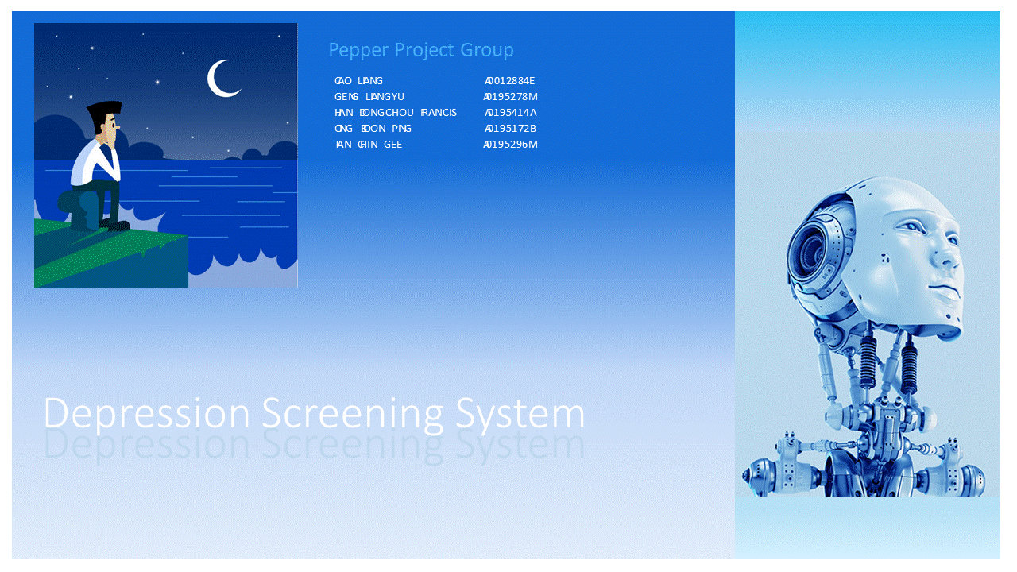
[Health] Depression Screener
Source https://github.com/IRS-MR/IRS-MR-2019-01-19-IS1PT-GRP-Pepper-DepressionScreeningSystem
Notes:
EXECUTIVE SUMMARY / PAPER ABSTRACT
One in four young Singaporeans show signs of depression. IMH treated 600 youths between 20 to 29-years-old last year alone. And one out of four people admitted to suffering from multiple symptoms of depression in a recent survey of youths aged 18 to 25. The study was conducted by students from Wee Kim Wee School of Communication and Information in NTU. We know that depression may lead to suicide. But other times, its sufferers become less productive and are more at risk for other diseases. The latest statistics on depression don’t paint a pretty picture of progress but it shows that the condition is more common than we think. Yet the stigma surrounding it walls off the victim who often suffers in silence. We need to seek out those who need help, and help them early. However, the challenge is that we do not have enough practitioners to do that.
This project serves to help Singapore tackle the immense problem of depression as well we alleviate the lack of practitioners to seek out those who need help. Using AI, we are trying to take a pro-active stand to detect depression condition in certain high-risk groups amongst the population, and as early on as possible. We leveraged tools like KIE Workbench, the Spring Boot etc to put together a framework for the application. This application can be used to seek out those who need professional assistance. With AI, we could apply some techniques like Certainty Factor, Decision Tree, and Inference Diagram to automate the screening of candidates. The screening is done at three levels:
Identifying the high risk group – Risk Profiling
Doing a 2-question survey (PHQ2)
Doing a 7-question survey (PHQ9) Level #1 can be applied to any organization, be it a school, a workplace, or even just targeting a segment of people. Once level #1 is done, those identified candidates can proceed to Level #2 and level #3 in a survey setting so that we can ascertain whether the candidate would likely be suffering from depression, and then recommending the next steps.

Slide 20
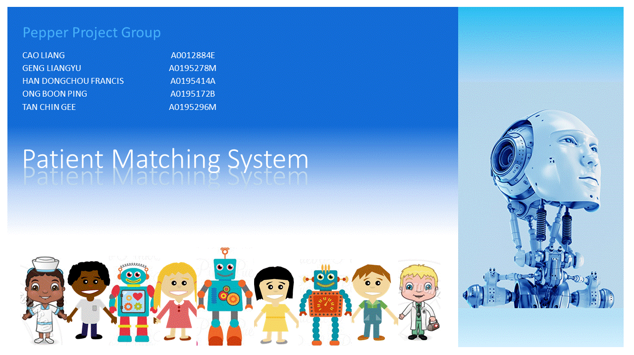
[Health] Patient-Doctor Matcher
Source https://github.com/IRS-RS/IRS-RS-2019-03-09-IS1PT-GRP-Pepper-PatientMatchingSystem
Notes:
EXECUTIVE SUMMARY / PAPER ABSTRACT
This project is a continuation from the Depression Screening System group project completed during the Machine Reasoning course. As a recap, the Depression Screening System deals with the problem of depression in youths and vulnerable segments of the community going undetected and untreated. It serves as an early warning system to put a spotlight on those vulnerable individuals who are displaying symptoms of depression. These vulnerable individuals can be spotted through the PHQ-9 Survey framework devised with the Depression Screening System. The output from that system is to provide a diagnosis (with a PHQ-9 score) on the level of severity of depression the individuals are having. In this phase of project, the objective is to use the PHQ-9 scores of the individuals and match them to the many practitioners in the community partners, hospitals and IMH. Why Patient Matching? When we churn out a list of patients in batches as part of the PHQ-9 Survey, there is also a need to do the matching with practitioners in batches. There are some challenges to match patients to practitioners. First of all, practitioners fall into roughly 3 categories – Counsellors, Psychologists, Psychiatrists. Then there is the time availability of the practitioners, as well as language ability, which are all hard constraints. Also there is location preference and gender preference which are soft constraints. Then there is the cost based on the practitioner selected, which is a soft constraint to minimize it. Using the State Space Search techniques embedded in the OptaPlanner, the Patient Matching System is able to optimally match a group of patients against a group of practitioners. The detail of how this match is executed will be covered in the next chapters. This system provides benefits to those who are diagnosed with depression by matching appropriate practitioners with the right expertise and in accordance to some set constraints.

Slide 21

[Manufacturing] Integrated Circuits Lot Disposition Recommender
Source https://github.com/IRS-MR/IRS-MR-2019-01-19-IS1PT-GRP-HEX-LOH_Disposition_Decision-Making_Process_System
Notes:
EXECUTIVE SUMMARY / PAPER ABSTRACT
In the semiconductor manufacturing, the reliability and integrity of the integrated circuits (ICs) are especially critical to the automotive and aerospace industries whereby any premature failure will lead to catastrophic consequences. The test process is the last quality gate before the ICs are shipped to the customers, and thus it is most important process in the whole manufacturing chain to ensure that there are no defect being shipped out.
Many companies place high emphasis on quality management and achieving ‘zero defect’. In quality management, the 6-sigma process control is widely used to improve quality and eliminate defects. When the lot (batch of ICs) does not meet the quality and customer requirements, the process control will flag and stop the lot from proceeding on to the packing process and the lot will be on hold (LOH). The LOH will then be sent for further investigation to assess its risk and understand the cause of the deviation which may arise due to product or process-related problems.

Slide 22
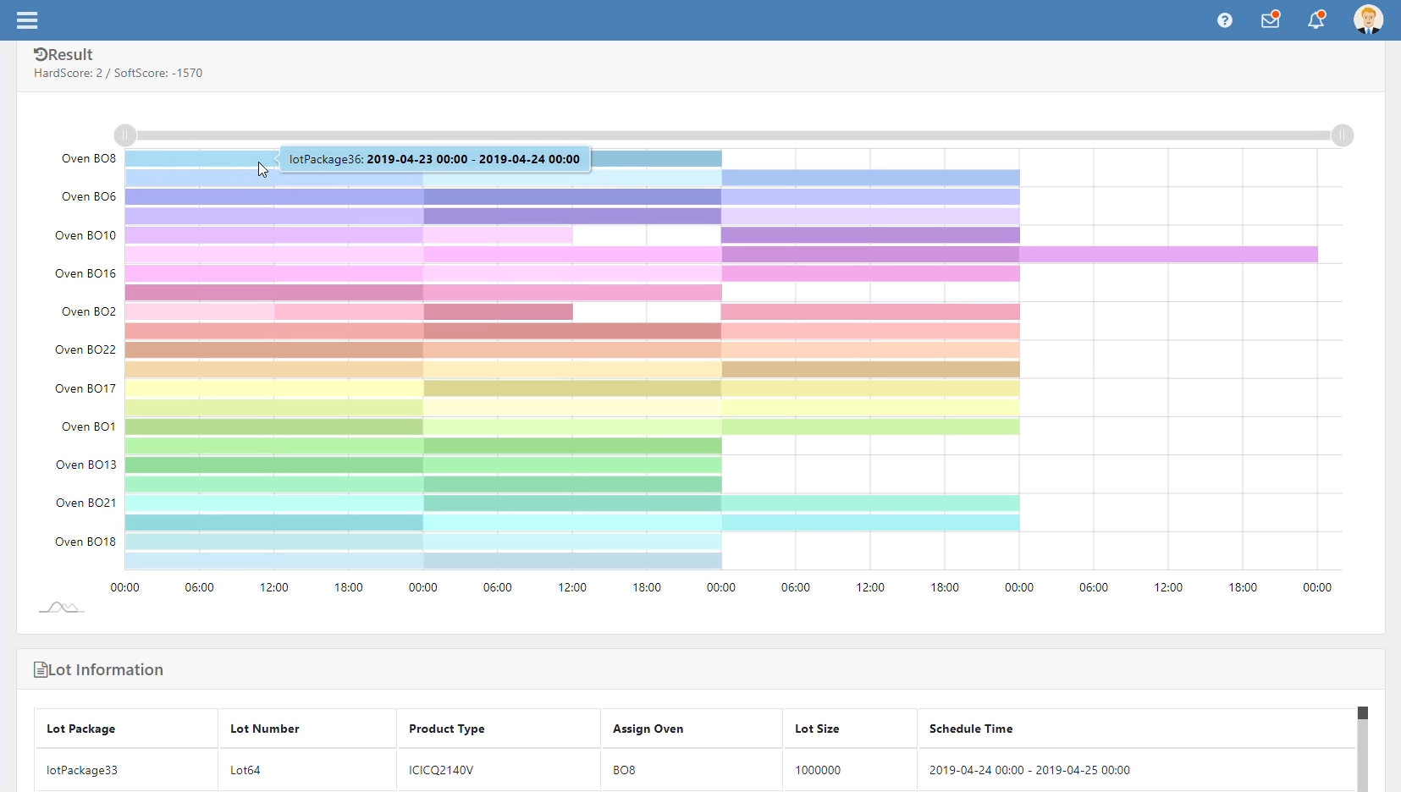
[Manufacturing] Integrated Circuits Lot-Oven Scheduling and Dispatch Optimizer
Source https://github.com/IRS-RS/IRS-RS-2019-03-09-IS01PT-GRP-Hex-Sdot_Scheduling_and_Dispatch_Optimization_Tool
Notes:
EXECUTIVE SUMMARY / PAPER ABSTRACT
The semiconductor backend testing is one of the most highly complex manufacturing systems in terms of equipment, process flows and interdependency relations. Furthermore, the complexity is increased due to a large product variety, complex product to tester relations, multiple level of tester to hardware dependency, sequence dependency, dynamic determination of processing and indexing time, batch processing and rework flow. Besides its complexity, the real production environment is also subjected to many uncertainties and unpredictable events due to continuous arrival of new and unforeseen orders and intermittent occurrence of machine breakdown, and random process and yield variations. Thus, the scheduling is no longer simply a static optimization problem, but an ongoing reactive process. Therefore, the scheduling operations and optimization in semiconductor backend testing are highly demanding and challenging for both researchers and practitioners.
Based on the above considerations given to the different facets in the scheduling process, this project aims to introduce a real-time manufacturing scheduler that is capable of helping the production accomplish operation strategies, optimize goals and deal with daily disruptions such as machine breakdown and WIP discontinuity in a more effective way.

Slide 23

[Health] Clinical Decision Support
Source https://www.redhat.com/en/resources/building-a-clinical-decision-engine-rtinsights-article
Notes:
https://www.redhat.com/en/resources/building-a-clinical-decision-engine-rtinsights-article
The role of “intelligent systems” in healthcare should be to augment or enhance – not replace – the hands-on services of physicians, clinicians and caregivers. Technology should empower providers to do their jobs even better, in a more informed and cost-effective way, and exponentially improve patient care. One healthcare institution delivering the right mix of technology to empower caregivers is New York’s Northwell Health. The organization employs state-of-the-art technology, while ensuring that the patient experience is welcoming, warm and well-informed. DECISION TIME The key to Northwell’s magic is a system designed to provide clinicians and caregivers with tools and resources to easily create their own applications, using patient information. Its system is designed to pull data from a variety of clinical sources and give recommendations for patient care. Access to suggestions and reports from this system is configurable by the clinician or caregiver, or team/committee – including physicians, nurses, technicians, and therapists – with little or no intervention from the organization’s information technology department required. Vipul Kashyap, Director of Clinical Information Systems and Enterprise Information Architect for Northwell Health, says the Clinical Decision Support system is designed to “enable a view of the business logic that is easily understood by a clinician, without the need to know a software programing language like SQL or Java.” The easy-to-adapt decision engine is part of his organization’s goal to “identify new and innovative ways of using technology to enable digital health and to enable better care, better outcomes, lower cost, and improve efficiency.” Kashyap defines the role of the engine as “the ability to provide recommendations and feedback to a physician at the point of care, or to a care coordinator when he or she is interacting with a patient.” The goal is to provide clinicians and caregivers a self-service environment in which they can provide clinical care in a more “rapid and innovative manner,” with the IT department in the background, continuing to provide basic infrastructure and tools. Information that flows through the decision engine comes via the health information exchange team at Northwell, of which Kashyap’s team is part. “We have built up hundreds of interfaces to multiple EMR, lab and other systems across the enterprise,” he explains. “It’s a huge challenge. The health information exchange team has been at it for the last five to six years. But we are in a good position where most of our data is integrated and easily available in a single place. That data can be mined for analytic insights, or leveraged by a decision engine to make recommendations.”

Slide 24

[Health] Meal Planner for Diabetics
Source https://github.com/IRS-RS/IRS-MRS-2019-07-01-IS01FT-GRP9-Meal-Planner-for-Diabetics
Notes:
EXECUTIVE SUMMARY / PAPER ABSTRACT
Diabetes Mellitus is a chronic condition in which the body has elevated glucose levels. It is a global public health problem and Type 2 diabetes accounts for around 90% of diabetes cases worldwide.Singapore ranks second in the proportion of diabetics among developed countries, behind US, with 10.63% of the population having the disease. Disturbingly, the prevalence of diabetes in Singapore is set to increase from 7.3% in 1990 to 15% in 2050, as people lead more sedentary lifestyles and consume high-energy diets.
Type 2 diabetes is a costly disease that can cause complications like blindness and lower limb amputation if not properly managed. Dietary intervention is key to maintaining blood glucose levels and managing the disease but people with the condition may not necessarily have the knowledge to make better food choices or they may find meal planning to be too time-consuming. Therefore, we decided to develop a meal planning system to help plan their meals and make it easier to manage the condition.

Slide 25

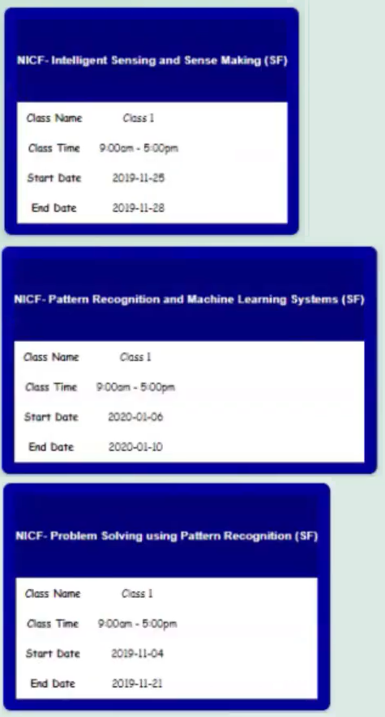
[Education] ISS Course Recommender
Source https://github.com/IRS-RS/IRS-MRS-2019-07-01-IS01FT-GRP1-ISS-COURSE-RECOMMENDER-SYSTEM
Notes:
EXECUTIVE SUMMARY / PAPER ABSTRACT
Singapore, as a nation, has been emerging as one of the smartest on Earth. The rapid advancements in digital technologies and the unfolding digital revolution has changed the way its inmates live work and play. The economy of Singapore is looking forward for more digital innovation techniques which can be incorporated in all the sectors in order to enhance itself. As mentioned in smartnation.sg few of the notable projects undertaken are as follows: Personal alert button trials, SGQR payment standards, use of bank cards for public transport, payment services bill, etc., As reported by Straitstimes, there were three major issues prevailing in this country as addressed by the Prime minister. One amongst them being handling big data to provide better public services. He also added that the aim of this nation is to have a digitally literate society for competing with the emerging cashless countries. Therefore, it is important to enhance the skills of people who are employed in the digital and the IT sector in order to achieve this goal.
The Institute of System Sciences at the National University of Singapore targets in developing Information technology and Communication leaders that drive business and organisation innovation. It offers a wide variety of programmes suitable for employed people who wish to sharpen their skills in data science, artificial intelligence, cybersecurity etc., Working people can gain knowledge and at the same time earn Professional Development Units (PDU) and showcase their skills in the digital industry. The “ISS-Course Recommender” project intends to cater the appropriate course for its user based on the details specified in their resume and the proficiency which they wish to inculcate in themselves. The system consists of a user interface in the form of a web page which encourages users to enter their resumes. Additionally, it also provides them with an application form wherein they can mention their details and their known and interested skills. The page then takes them through the main list of programmes available at ISS and asks the user to choose from. Once the user has made the selection, it puts forward a list of sub programmes and its description. Once the necessary choices are picked up, the user is acknowledged with the schedule of the selected course.

Slide 26
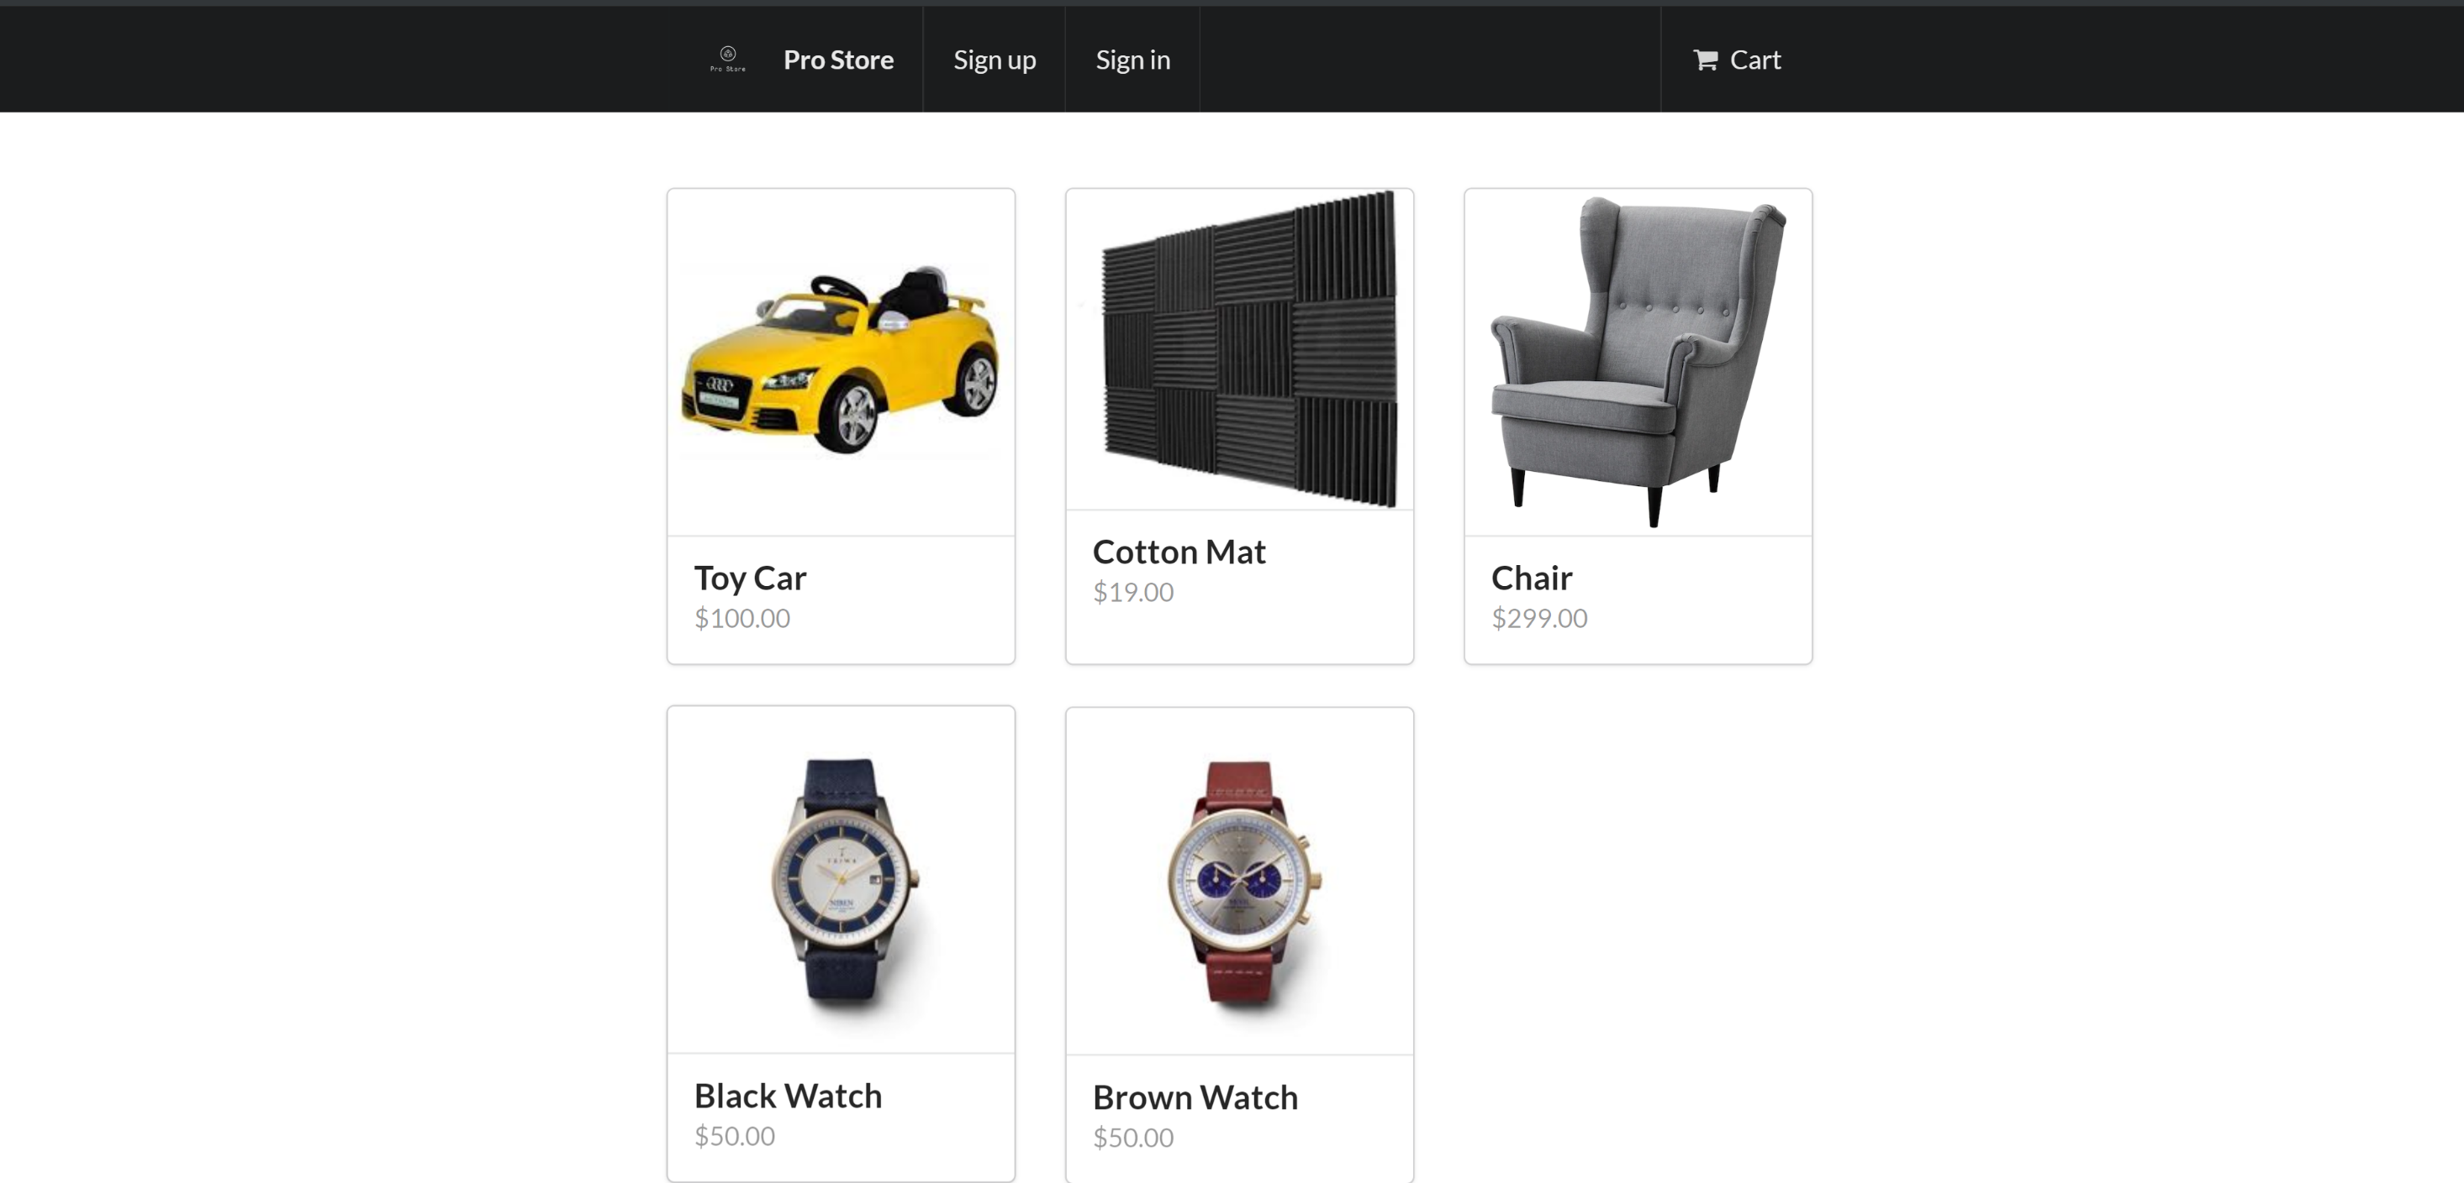
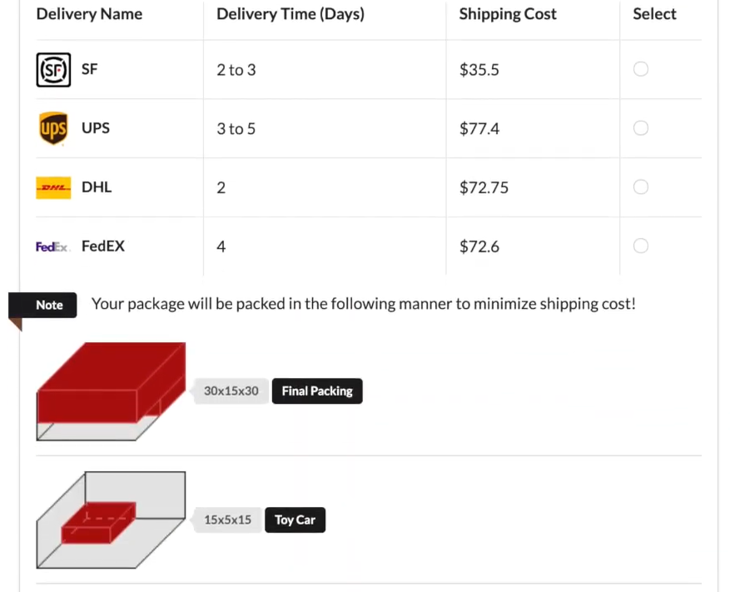
[E-Commerce] Shipping and Packing Optimizer
Source https://github.com/IRS-RS/IRS-MRS-2019-07-01-IS01FT-GRP5-Intelliship
Notes:
EXECUTIVE SUMMARY
In the past few years, e-commerce and online shopping have become more and more popular. In some markets, it even becomes an essential part of daily lives. A lot of small and medium size merchants have emerged to capture the business opportunities. While setting up an online store is easier now because of the mature platforms like Woocommerce and Shopify, there are still many challenges for small and medium sized online merchants. One of them is pack and shipping. Packing and shipping is particularly hard to handle because different merchants will have different types, sizes and combinations of products. Packing problem refers to how to pack the ordered goods in the basket in order to minimize volume, which in turns minimizes shipping cost. Shipping problem refers how to find the cheapest available option for customer to minimize their shipping cost and thus induces more sales. In this project we interviewed several online merchants who sell internationally. We understand their current challenges and designed this smart shipping options generator and cost calculator. We will use DHL, UPS, Fedex and SF Express as example. We will configure their shipping rates into the system, where our rules-engine will find the optimal shipping rates based on the weight and destinations. We also leverage third party library for the packing optimization problem in order to minimize shipping cost.

Slide 27
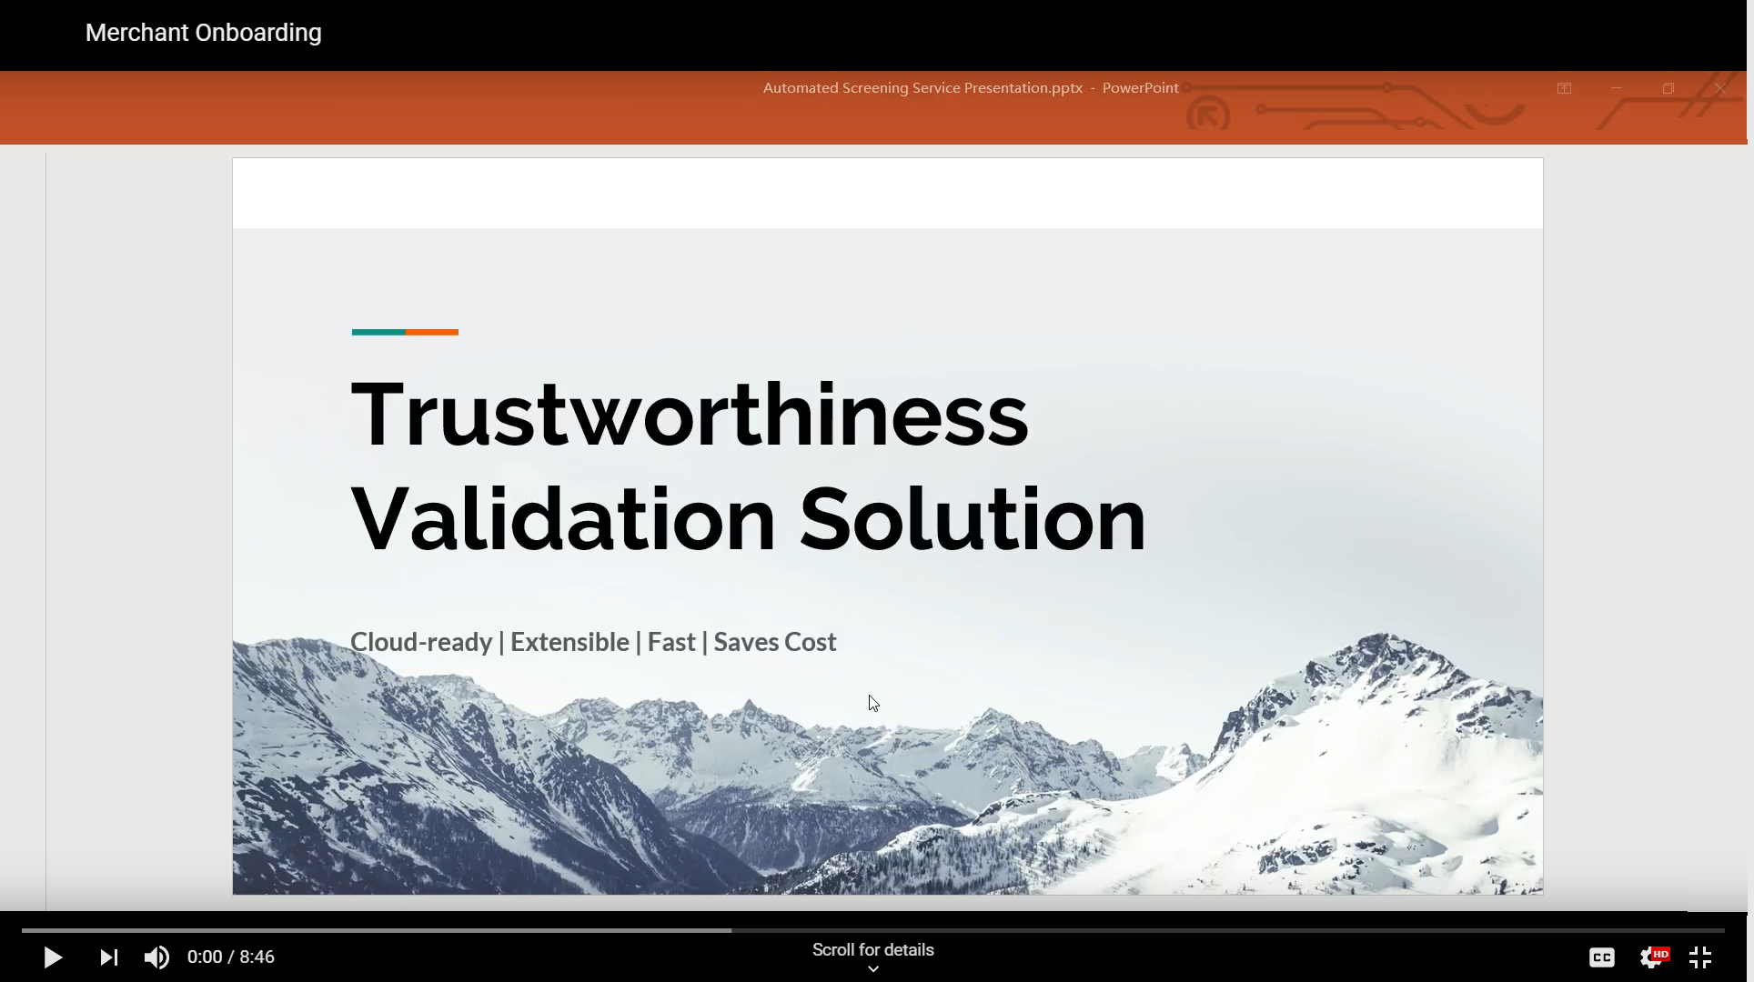
[FinTech] Merchant On-boarding

Slide 28
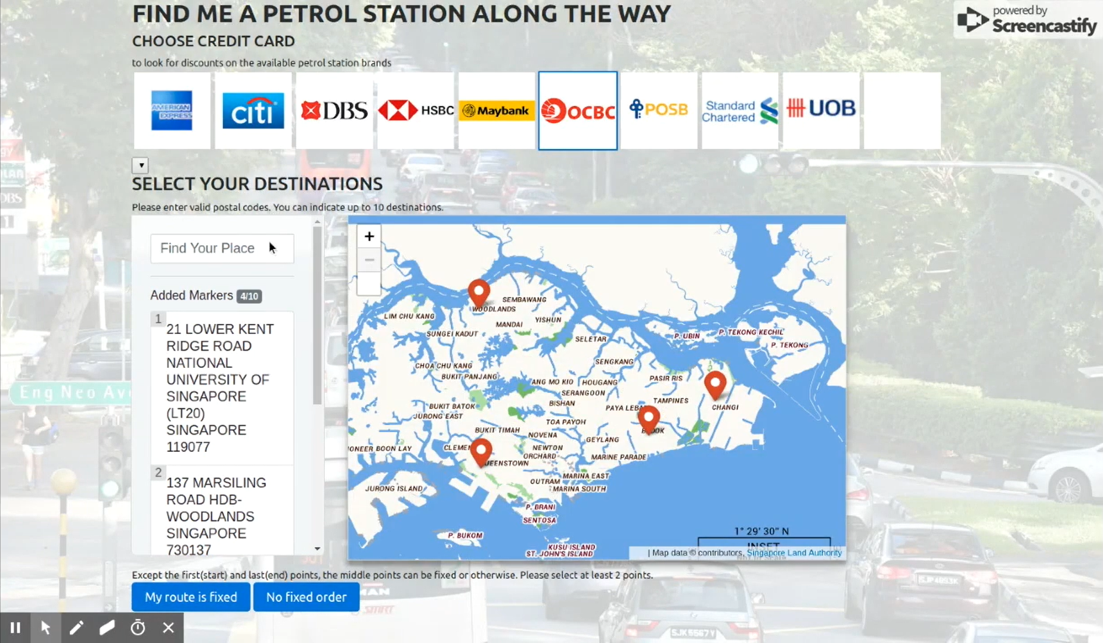
[FinTech] Co-branded Petrol Credit Card

Slide 29
End of notes

